Slide 1
Dynamic Programming

Slide 2
Objectives
Definition
Policy goodness
State-value function
Bellman equation
Action-value function
Optimal Policies
Policy Evaluation
Optimal Policies
Policy Improvement
Policy Iteration
Value Iteration
Drawbacks
Generalized Policy Iteration

Slide 3
Definition
Algorithms to compute optimal policies for a MDP, given a perfect model of the environment
Notice: in some way they are cheating
require full access to the MDP
because they depend on knowing the dynamics of the environment
which is something we can’t always obtain
They are important theoretically
When an agent has full access to the MDP, there’s no uncertainty because he can look at the dynamics and rewards and calculate expectations directly
no need for exploration, for interaction or for trial-and-error learning

Slide 4
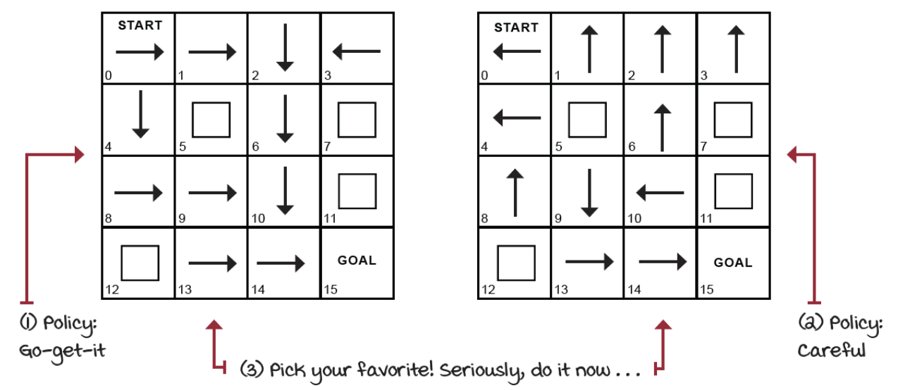
Policy goodness (1)
How good is a policy?
How much better is a policy compared to another policy?
Consider the following policies for the frozen-lake environment:

Slide 5


Policy goodness (2)
We can use a brute-force approach
simulate the environment for a long time
then average the returns and evaluate the success probability
See “brute-force-evaluation.ipynb” notebook
Go-get-it policy
Careful policy
It seems Go-get-it doesn’t pay well in the FL environment!
However, the brute-force approach is not a good idea, because it is very inefficient. We need a better way to evaluate policies.

Slide 6
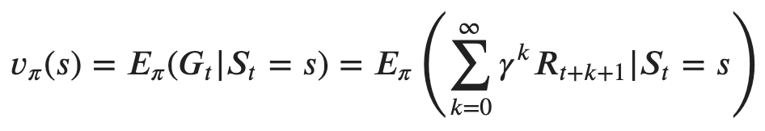
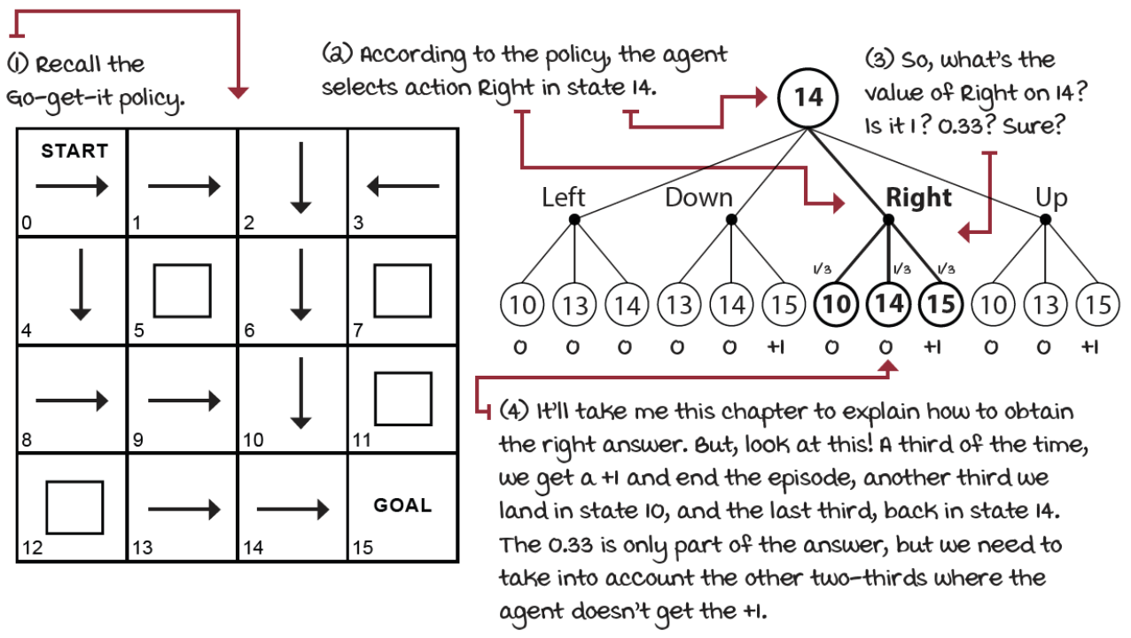
State-value function
We can calculate the expected return starting from every single state
For example, if we follow "go-get-it" policy from state 14, we get:
it isn’t straightforward to calculate because of the dependence on other states (10 and 14,) which we don’t have either and one is the same state!

Slide 7
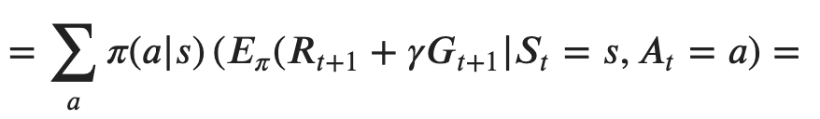
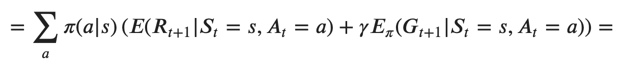
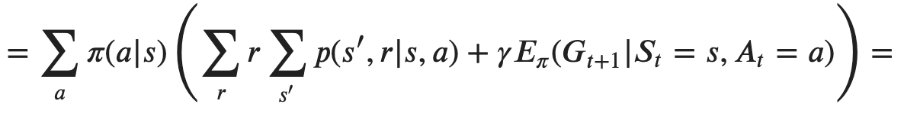
Bellman equation (1)
We can use the recursive definition of the return:
apply the law of total expectation:
split the expectation of a sum into a sum of expectations and note that, given an action, the expected immediate reward doesn't depend on the policy:
write the expected immediate reward in terms of the system dynamics:

Slide 8
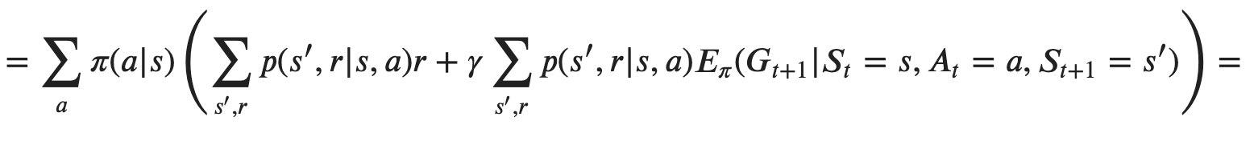
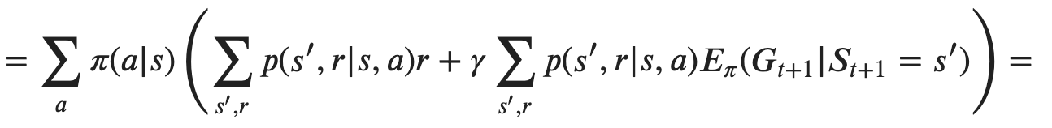
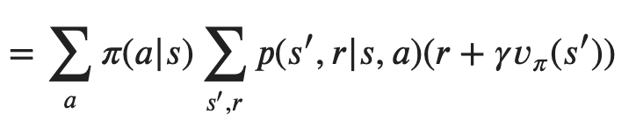
Bellman equation (2)
apply the law of total expectation on the next state:
Markov property: knowing 𝑆_{𝑡+1} makes the expectation independent of 𝑆_{𝑡} and 𝐴𝑡:
note that 𝐸_{𝜋}(𝐺_{𝑡+1}|𝑆_{𝑡+1}=𝑠′)=𝑣_{𝜋}(𝑠′) and combine summations:

Slide 9
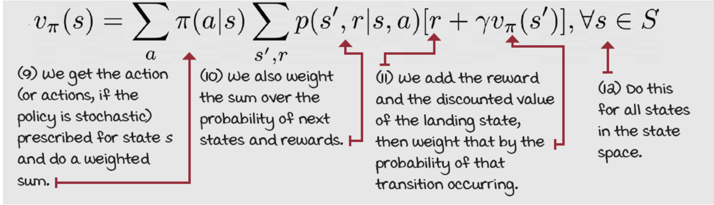
Bellman equation (3)
The value of a state is equal to the (discounted) value of the expected next state, plus the reward expected along the way:
Notice how the value of a state depends recursively on the value of possibly many other states, which values may also depend on others, including the original state!

Slide 10
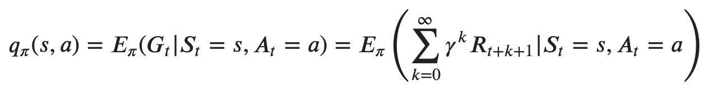
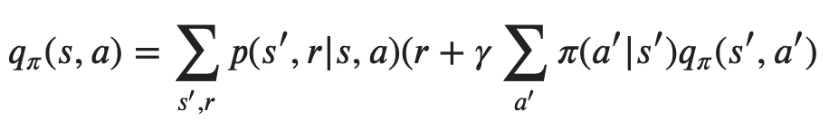
Action-value function (Q-function)
However, the critical question isn’t merely about the value of a state, but the value of taking an action in a state!
For instance, the “go-get-it” policy goes right when in state 14, but the “careful” policy goes down
which action is better?
which action is better under each policy?
We can define the action-value function (Q-function) as the expected return if the agent follows a policy after taking an action in state:
We can provide a formulation of the Bellman equation also for the action-value function with similar reasoning:

Slide 11


Optimal Policies
We can compare policies and define an ordering over them:
a policy 𝜋 is defined to be better than or equal to a policy 𝜋′ if its expected return is greater than or equal to that of 𝜋′ for all states:
there is always one policy better than or equal to all others, this is optimal policy 𝜋∗
Optimal state-value function has maximum value across all policies:
Optimal action-value function has maximum value across all policies:
Once we have an optimal state-(action-)value function, it is easy to determine an optimal policy
This relies on at least three assumptions (rarely true in practice):
we accurately know the dynamics of the environment
we have enough computational resources to complete the computation of the solution
the Markov property

Slide 12
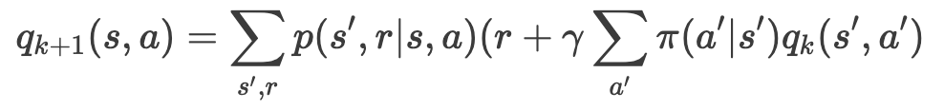

Policy Evaluation (1)
We can consider an initial random approximation 𝑣₀, then we can get successive approximation using the Bellman equation as an update rule:
The sequence 𝑣_{𝑘} converge to 𝑣_{𝜋} as 𝑘⟶∞
we can stop short when variations are sufficiently small
Notice that we update estimates on the basis of other estimates: this general idea is called bootstrapping
Notice that the k here are iterations across estimates, they’re not interactions with the environment
these aren’t episodes, these aren’t time steps
just the iterations of the iterative policy evaluation algorithm

Slide 13
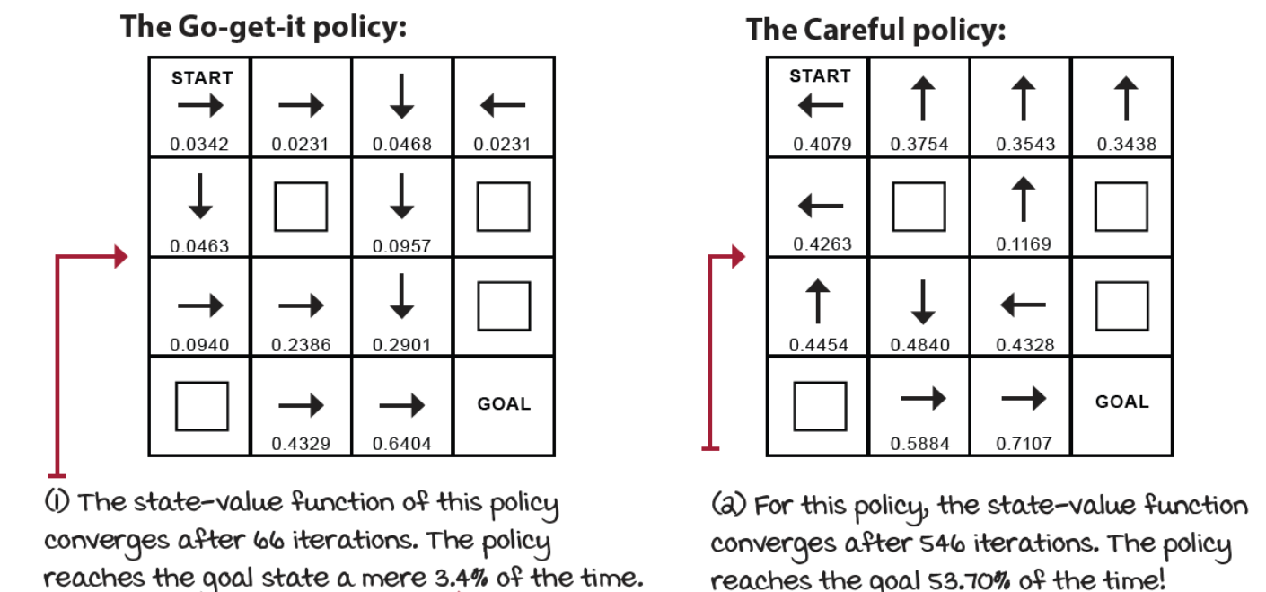
Policy Evaluation (2)
We can apply the policy evaluation algorithm to the FL environment to compare “go-get-it” and “careful” policies
See “policy-evaluation.ipynb” notebook
As already seen, Go-get-it policy doesn’t pay well in the FL environment! Whereas the Careful policy is much better.
A question arises: are there any better policies for this environment?

Slide 14
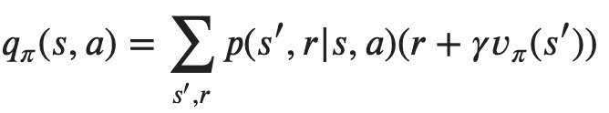
Policy Improvement (1)
Value functions helps find better policies
suppose we have determined the value function 𝑣_{𝜋} for a policy 𝜋
for a state 𝑠, we would know if we should change the policy and choose 𝑎 ≠ 𝜋(𝑠)
we know how good is to follow the policy (it is 𝑣_{𝜋}(𝑠) ), but would it be better to change?
To answer we consider selecting 𝑎 in 𝑠 and then following the policy 𝜋:
if it is greater than 𝑣_{𝜋}(𝑠), it is better to select 𝑎 in 𝑠
This is a case of the general policy improvement theorem
let 𝜋 and 𝜋′ a pair of policies that:
In the example:
the original policy 𝜋 and the changed policy are identical, except for the different action taken in state 𝑠
if 𝑞_{𝜋}(𝑠,𝑎) > 𝑣_{𝜋}(𝑠) , then the changed policy is better than the original one

Slide 15
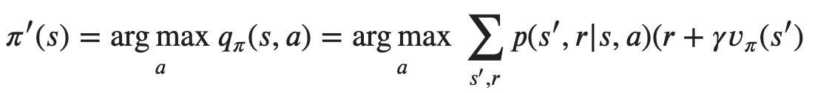
Policy Improvement (2)
It is natural to extend to consider changes at all states and to all possible actions, selecting at each state the action that appears best according to 𝑞_{𝜋}(𝑠,𝑎) :
The process of making a new policy that improves an original policy by making it greedy with respect to the value function of the original policy, is called policy improvement

Slide 16
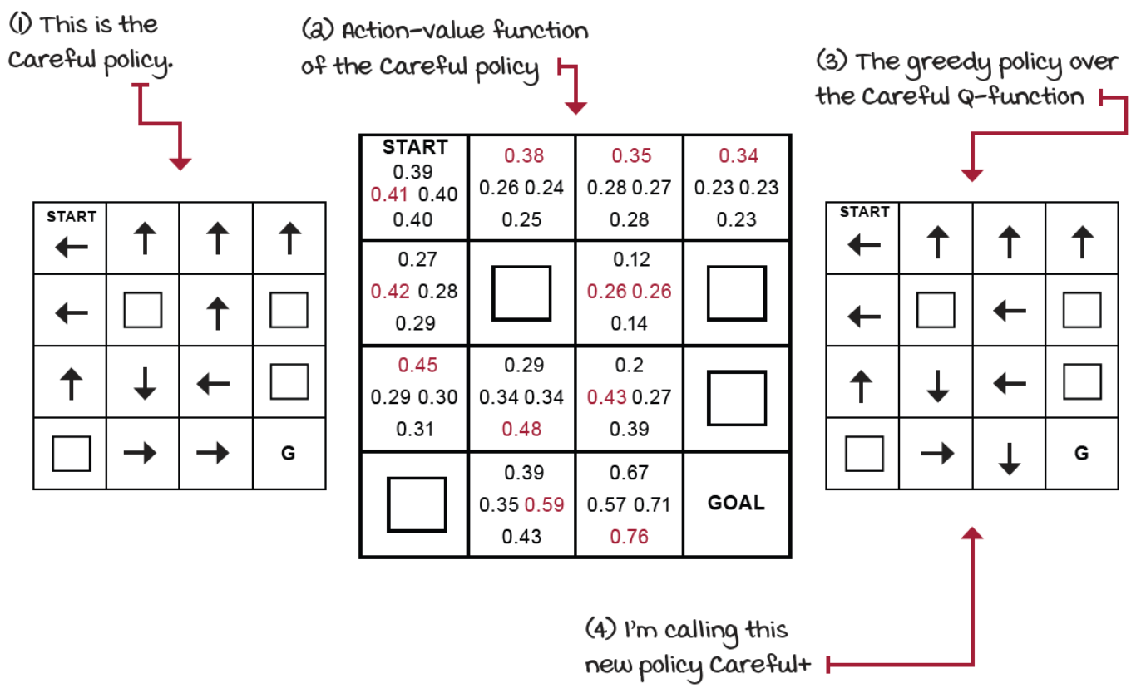
Policy Improvement (3)
We can apply the policy improvement algorithm to the fronzen lake environment to improve the “careful” policy
Notice if we act greedily with respect to the action-value function of the policy, we obtain a new policy: “careful-plus”

Slide 17
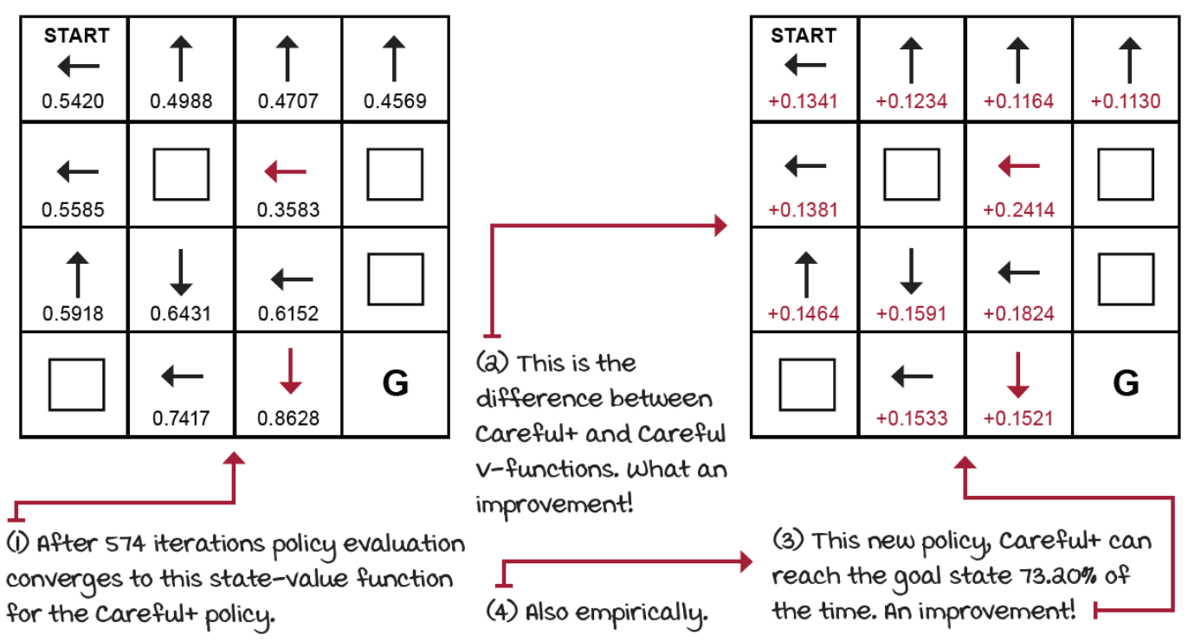
Policy Improvement (4)
Is this policy any better? Well, policy evaluation can tell us
See “policy-improvement.ipynb” notebook

Slide 18
Policy Iteration
Once a policy has been improved using its value function to yield a better policy, we can then compute a new value function and improve again to yield an even better policy
a sequence of monotonically improving policies and value functions
Each policy is guaranteed to be a strict improvement over the previous one (unless it is already optimal)
Because a finite MDP has only a finite number of policies, this process must converge to an optimal policy in a finite number of iterations
See “policy-iteration.ipynb” notebook
We have considered the special case of deterministic policies, anyway all the ideas extend easily to stochastic policies
each action gets portion of the probability of being selected in the new greedy policy

Slide 19
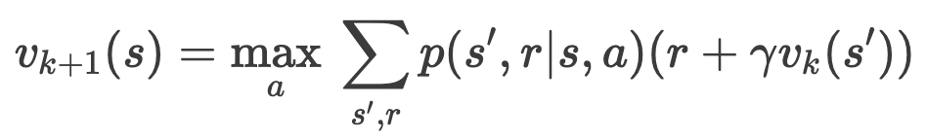
Value Iteration (1)
Policy interaction works, but slowly
each iterations involves evaluation: a protracted iterative computation requiring multiple sweeps through the state set
We can truncate evaluation after a single iteration
still an improvement upon the initial policy
It that case we calculate the greedy policy as soon as we can, greedily
don’t wait until we have an accurate estimate of the policy before improving
instead, we truncates the evaluation phase after a single state sweep
We can merge the truncated evaluation step and the improvement step into the same equation:
instead of taking the argmax to get a better policy and then evaluate this improved policy to obtain a new value function
we directly calculate the maximum (max, instead of argmax) value across the actions to be used for the next sweep over the states

Slide 20
Value Iteration (2)
The sequence 𝑣_{𝑘} can be shown to converge to 𝑣∗
Like policy evaluation, value iteration formally requires an infinite number of iterations to converge exactly
in practice, we stop once the value function changes by only a small amount
Notice that in practice, in value iteration, we don’t have to deal with policies
it doesn’t have any separate evaluation phase that runs to convergence
While the goal is the same as of policy iteration (to find the optimal policy) it happens to do this through the value functions (thus the name)
Only at the end of the algorithm, after the value function converges to the optimal, do we extract the optimal policy by taking the argmax over the actions of the action-value function
See “value-iteration.ipynb” notebook

Slide 21
Drawbacks
Dynamic programming can be used to compute optimal policies, but it require a perfect model of the environment
these methods in a way "cheat": they require full access to the MDP
they depend on knowing the dynamics of the environment, which is something we can’t always obtain
Another major drawback is that it involve operations over the entire state set
if the state set is very large, then even a single sweep can be prohibitively expensive
for example, backgammon has over 10²⁰ states…
Asynchronous dynamic programming are iterative algorithms that are not organized in terms of systematic sweeps of the state set
avoiding sweeps does not mean that we can get away with less computation
it just means that an algorithm does not need to get locked into any hopelessly long sweep before it can make progress improving a policy

Slide 22
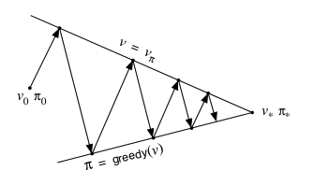
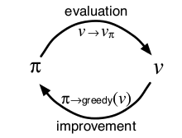
Generalized Policy Iteration
Two simultaneous, interacting processes
one making value function consistent with the current policy (evaluation)
the other making the policy greedy with the current value function (improvement)
These two processes alternate
each completing before the other begins (policy iteration)
only a single iteration of evaluation is performed before each policy improvement
or the two can be interleaved at an even finer grain (asynchronous methods)

